Slide 1



Social Buzz
Content Category Analysis
November 28, 2023

Slide 2


Today's agenda
Project Recap
Problem
The Analytics Team
Process
Insights
Summary

Slide 3

Social Buzz is a technology company that needs to scale quickly in order to accommodate its rapid growth in users and content
Accenture has taken up a 3 months project to address the following task.
Audit of Social Buzz big data practice
Recommendations for a successful IPO
Analysis of Social Buzz Content Category
Project Recap

Slide 4

Problem
Firm is growing too rapidly than anticipated. Over 100,000 posts / day
No expertise to handle scaling process
No expertise to handle the hiring of more competent people
Managing challenges of big data
Understanding best practices in data management

Slide 5



Andrew Flemming
Chief Technical Architect
The Analytics team
Marcus Rompton
Senior Principle
Oyindamola Olushile
Data Analyst

Slide 6
Process
1
Data Understanding
2
Data Cleaning
3
Data Modelling
4
Data Analysis
5
Insights

Slide 7

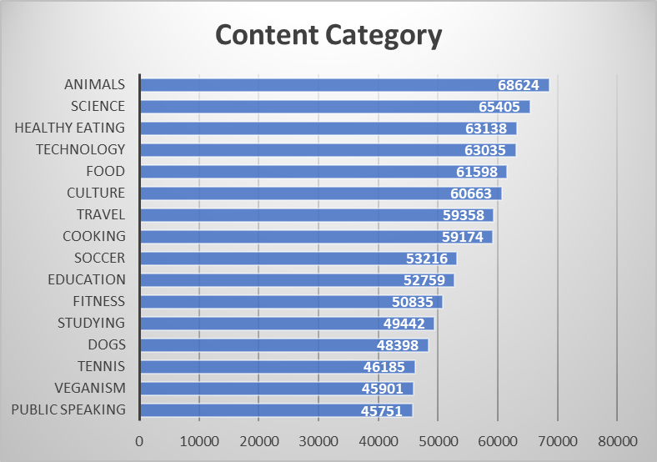

Insights
There were 16 content categories in total in the financial year 2020/2021 with the Animal category being the most popular and public speaking category being the least popular.

Slide 8
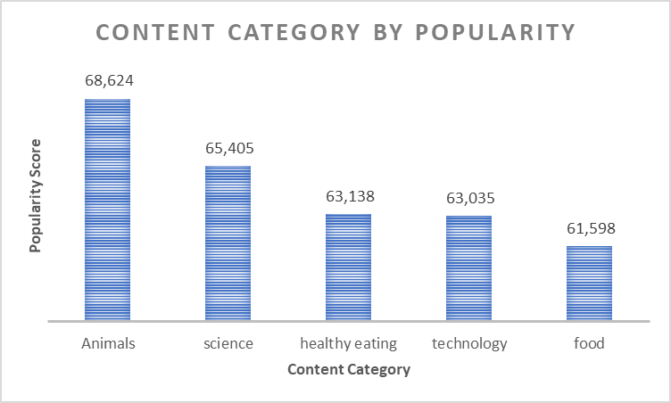


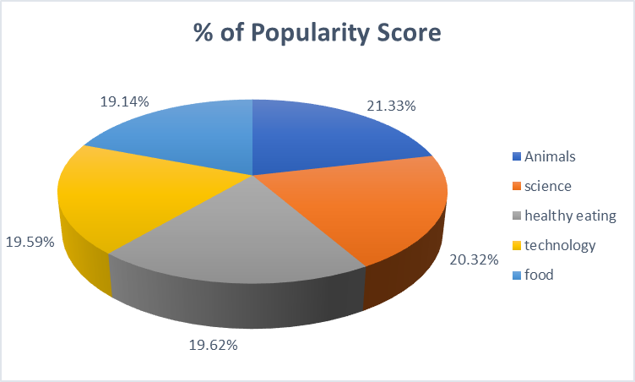
Insights
The Top 5 Content Categories with the highest popularity for the year ended June 2021 were Animal, Science, Healthy eating, technology and Food
The percentage popularity score also indicates Animal content had the highest score suggesting users are more concerned about information regarding animals

Slide 9
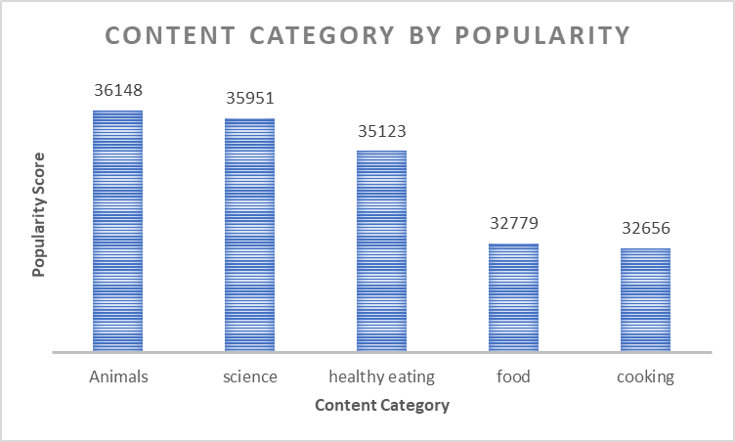


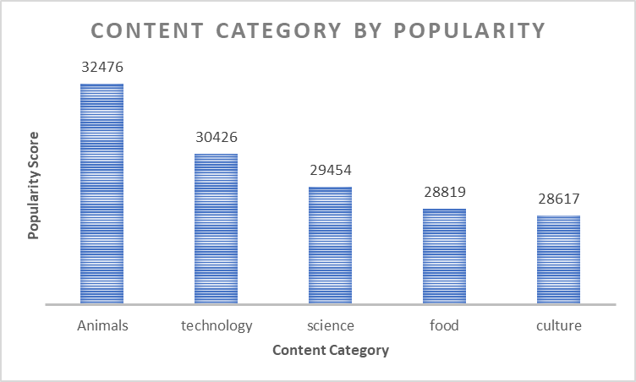
Insights
In half year 2020, cooking category made it to the top 5 content
In half year 2021, culture information made it to the top 5 content categories

Slide 10
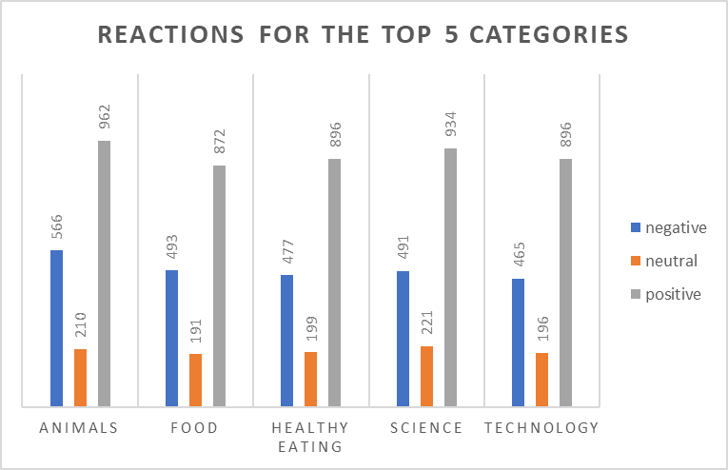


Insights
Animal category had the most reaction with 566 negative sentiments, 210 neutral sentiments and 962 positive sentiments
The month of May 2021 had the highest post totally 1,954 followed by the month of Jan 2021 which had 1,949 posts

Slide 11

Users are more interested in animal content suggesting that majority of the users are animal lovers
Most users were also interested in science, healthy living, and technology indicating that users are supporters of technology and the impact it can make on the environment
Summary
Social buzz can leverage on the top content category each month to inform marketing strategy

Slide 12
Thank you!
ANY QUESTIONS?

